Slide 1
Super Transport
Theo Hepburn

Slide 2
What is Super Transport?
A transport controller
Can be used for Logic Pro X and Pro Tools 12
Quick access to transport controls and key commands

Slide 3
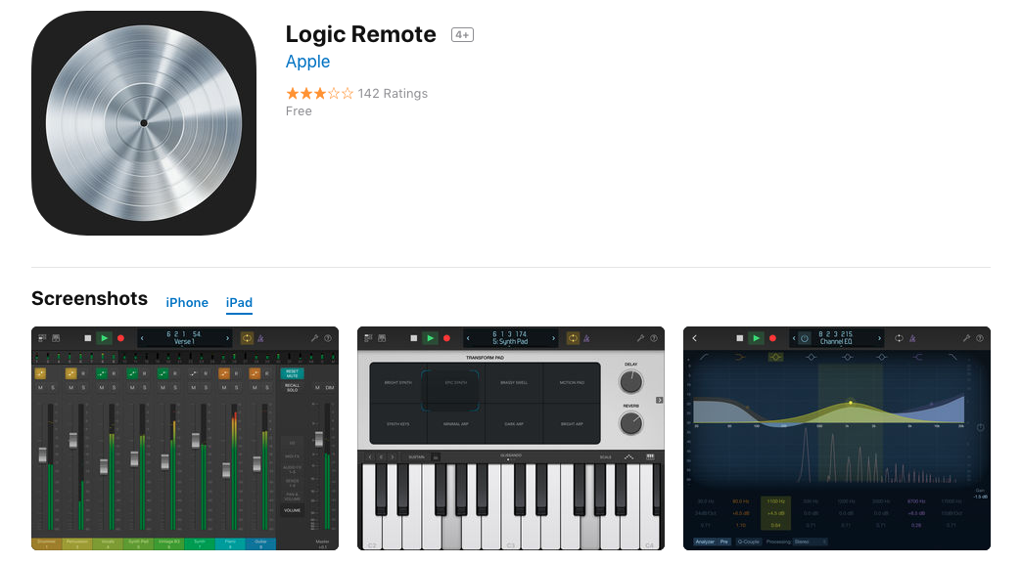
Existing Products
(Apple, 2013)

Slide 4
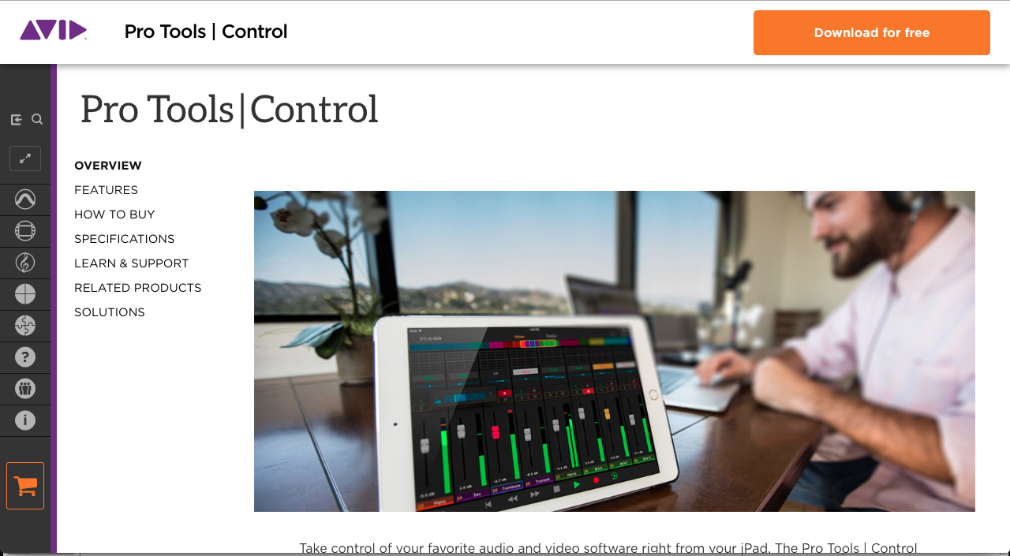
(Avid, 2018)

Slide 5
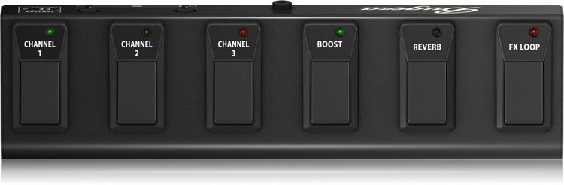
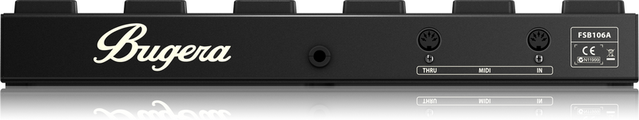
Bugera FSB106A 6-Button Footswitch.
Notes:
The original idea for this assignment was to, create a playback controller for drummers that would be controlled using a Bugera FSB106A 6-Button Footswitch.
Play // Stop // Rewind // Fast Forward // Record // Loop
However, because of the lack of connective capabilities it was decided to use the Behringer BCF2000 which resulted in the original idea being adapted.
Instead of making just a playback controller, it was decided to construct a transport controller that could be used with both Logic Pro X and Pro Tools 12.

Slide 6
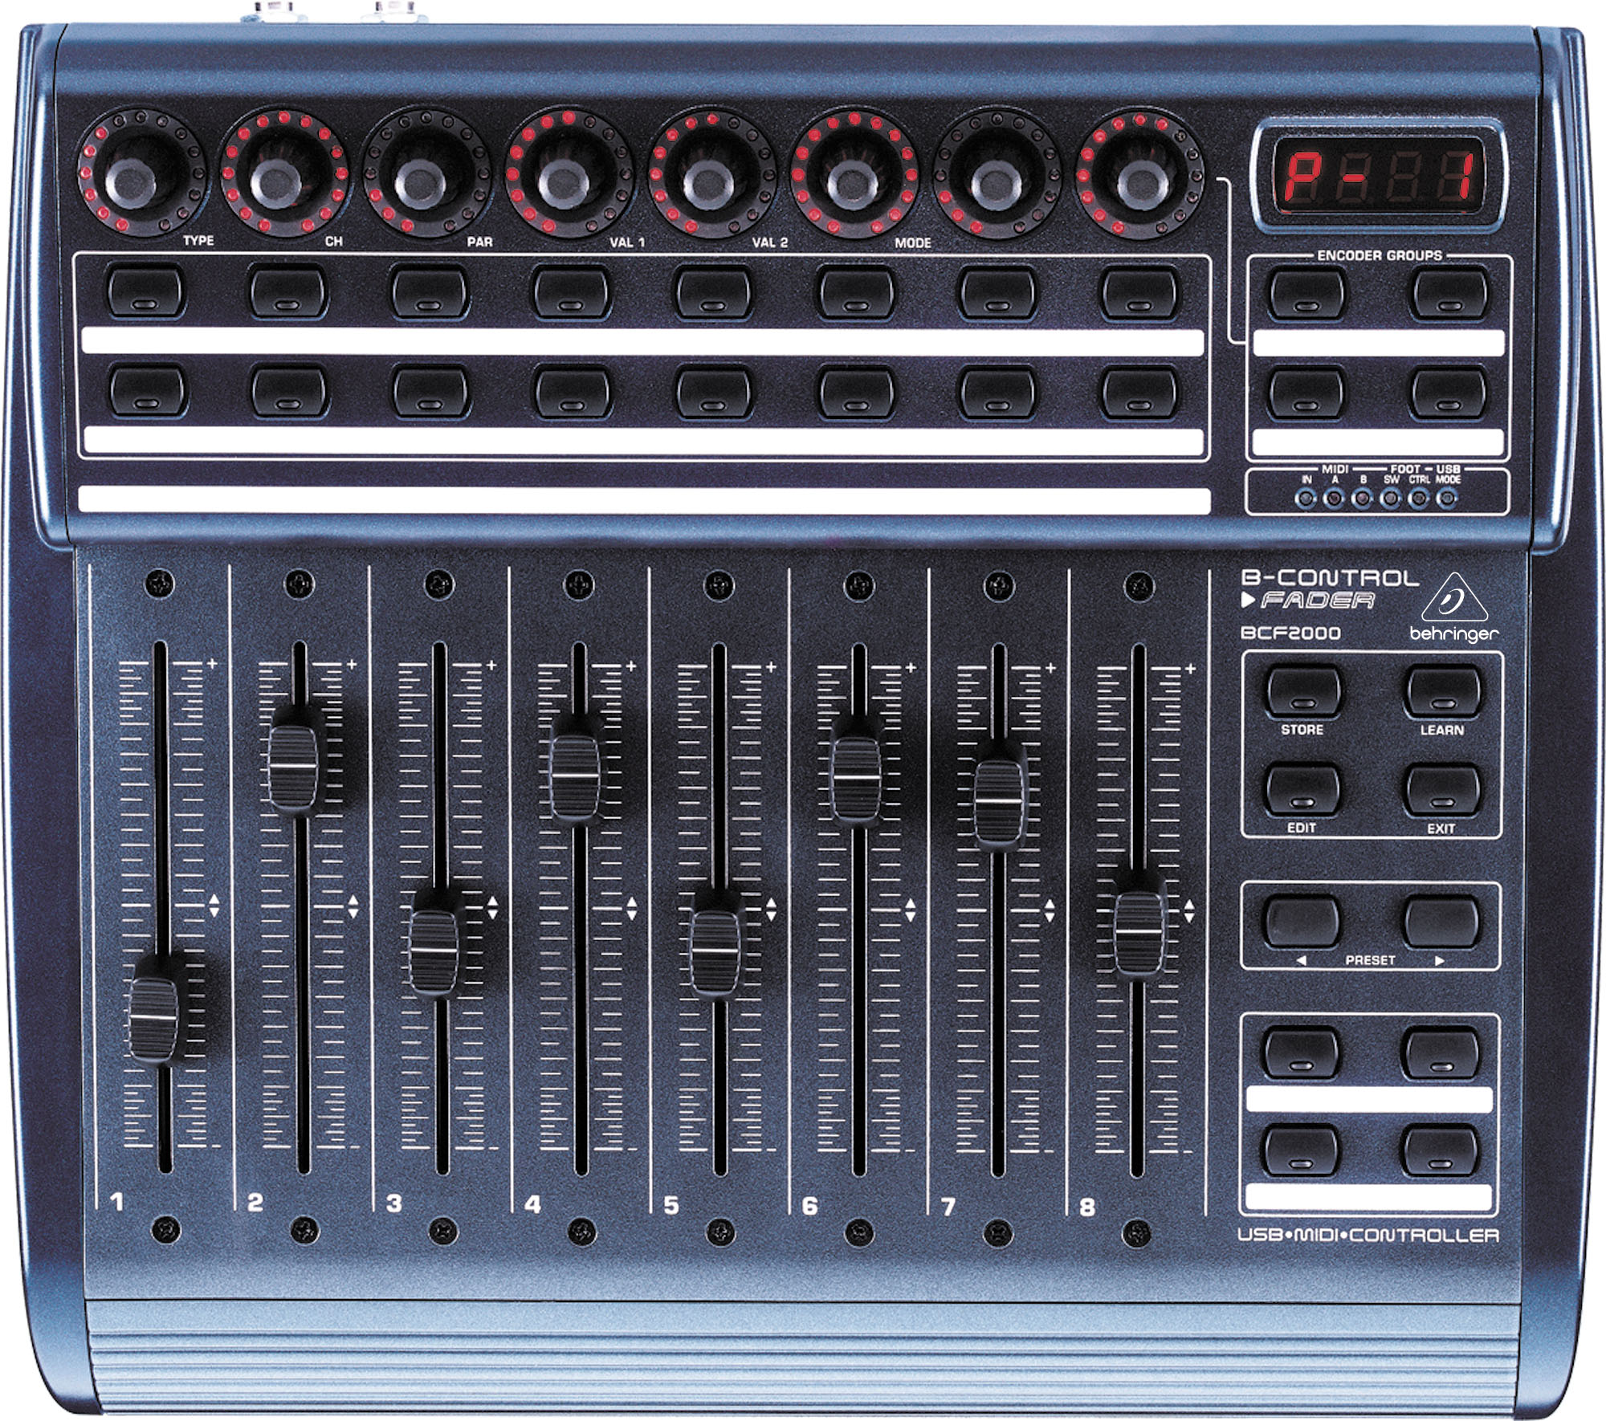
Behringer BCF2000
Notes:
As the BCF2000 had more than 6 buttons it meant that it could be connected to more than 6 parameters. \
Logic Pro X
Play // Play From Beginning // Stop // Rewind // Fast Forward // Record // Cycle // Save // Click (on/off) // Count in // Mixer
Pro Tools:
Play // Stop // Rewind // Fast Forward // Record // Playback Select (loop/normal) // Save

Slide 7
Why?
Aimed at users who self engineer their sessions
Musicians who to record themselves from a recording booth
Notes:
I wanted to make something that I feel was needed.
Used a hardware controller because it is more stable. Some studios may not have Wi-Fi enabled on their systems so the Logic and Pro Tools remotes may not work.
Likewise, if the internet connectivity is weak. The remotes may not work.

Slide 8
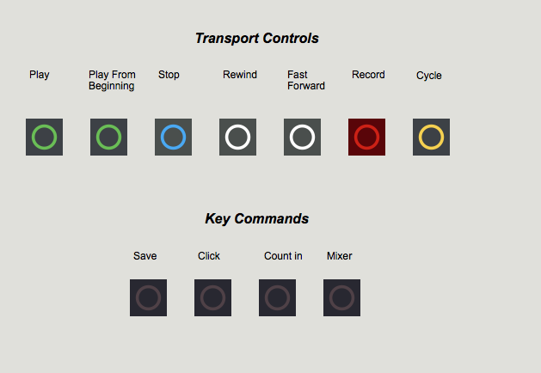
Max MSP Patch
Logic Pro X Tab

Slide 9
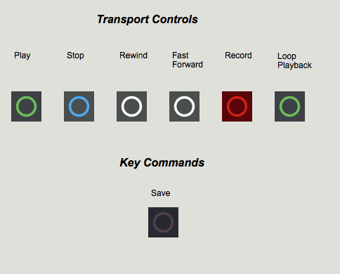
Max MSP Patch
Pro Tools 12 Tab

Slide 10
References
Apple (2013). Logic Remote. [image] Available at: https://itunes.apple.com/us/app/logic-remote/id638394624?mt=8 [Accessed 15 May 2018].
Avid (2018). Pro Tools. [image] Available at: http://www.avid.com/products/pro-tools-control [Accessed 15 May 2018].

